Slide 1

Network Detection
Implementing and Analysis of JA3 data for TLS Fingerprinting using Bro/Zeek Data
By: Ahmed Techini,
M.Eng., Eng., CISSP, CEH, CCNA

Slide 2
Whoami
Security Solution Architect at Bank of Canada
Teaching Cyber Security at École Polytechnique of Montréal

Slide 3
Problem Statement
Lack of visibility for encrypted traffic.
Effectiveness of network detection approach.
No correlation between host telemetry, network telemetry ,etc.

Slide 4
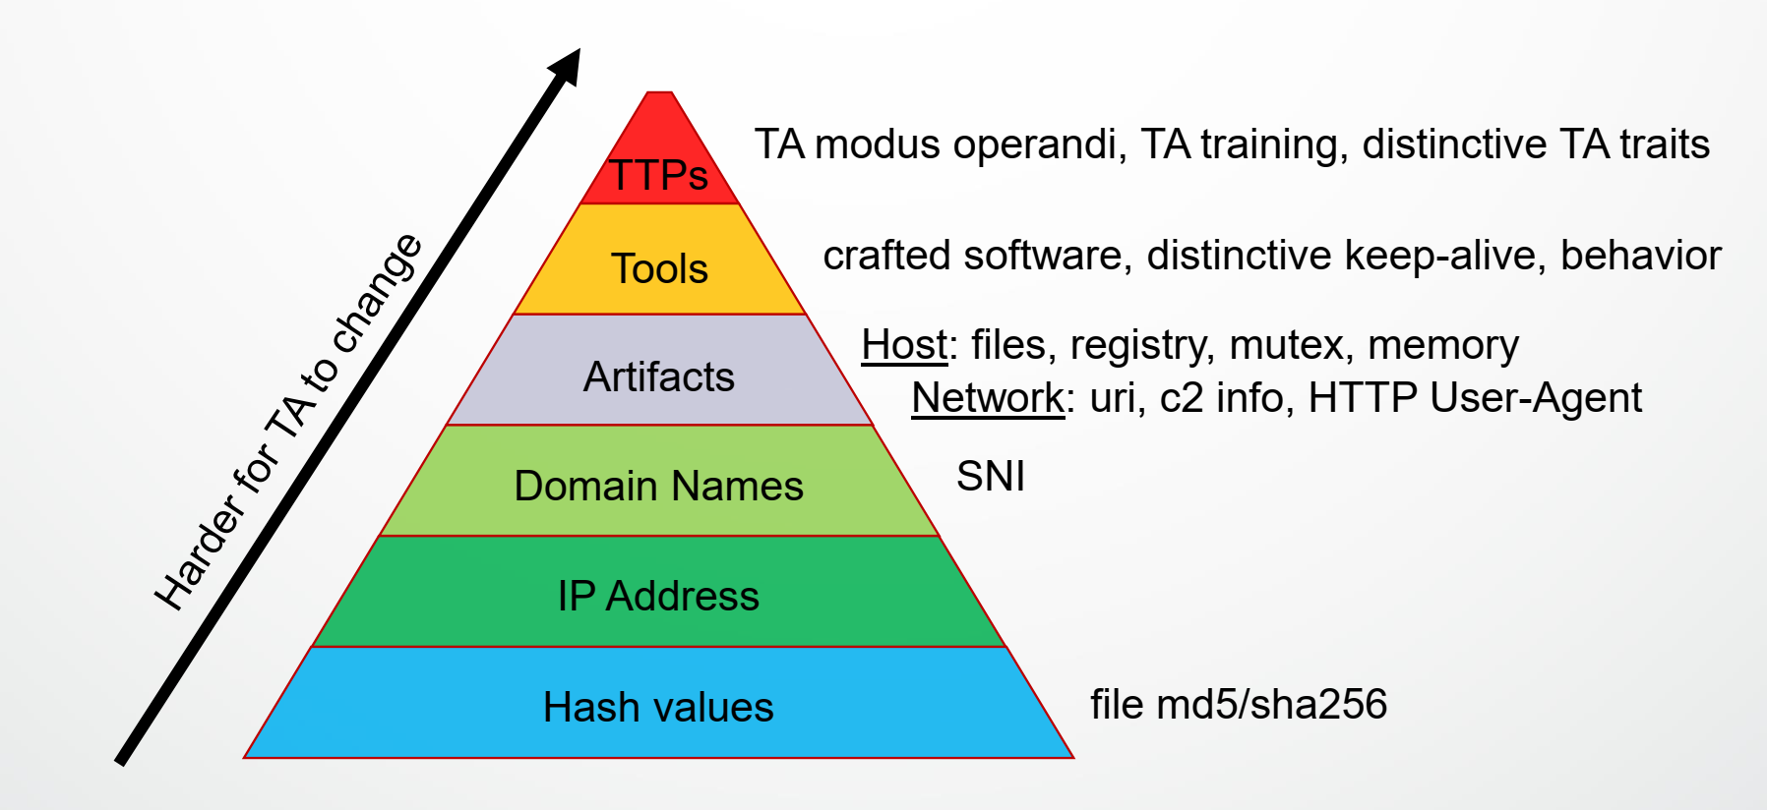
Pyramid of Pain: Effectiveness Measure
TA: Threat Actor
Source: David Bianco

Slide 5
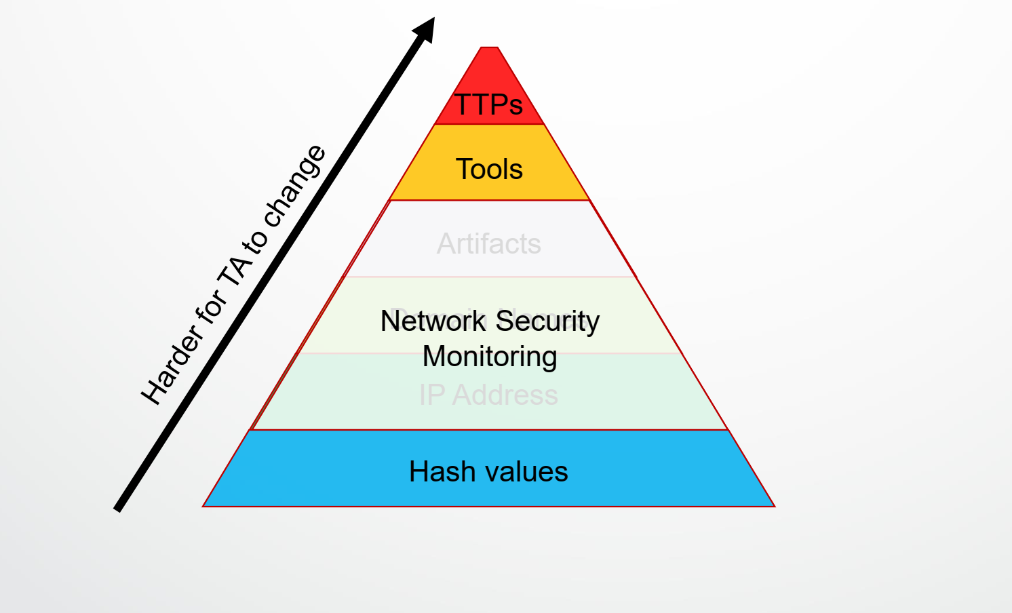
Pyramid of Pain: NSM Effectiveness
Source: David Bianco

Slide 6
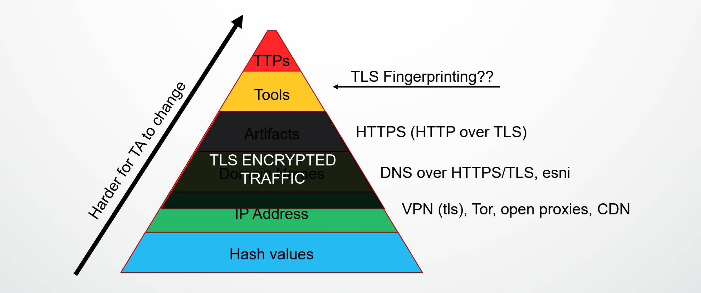
Pyramid of Pain: Encrypted Traffic
Source: David Bianco

Slide 7
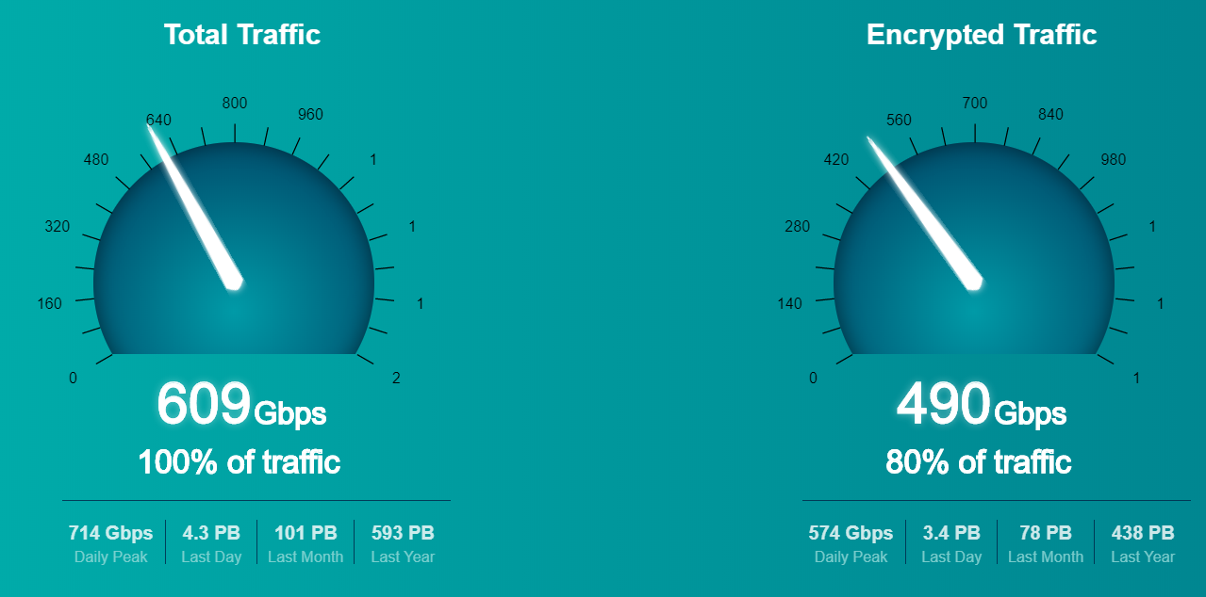
Encrypted traffic: The rise of TLS (~50%-90%)
Source: ZScaler

Slide 8
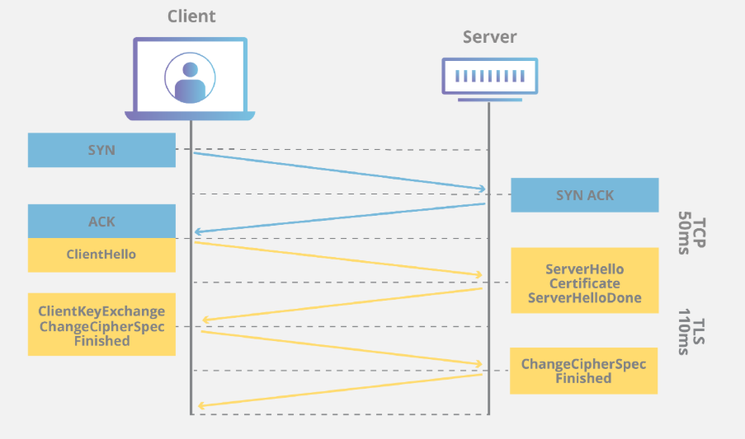
TLS Handshake
TLS is an encryption protocol designed to secure Internet communications. A TLS handshake is the process that kicks off a communication session that uses TLS encryption.

Slide 9
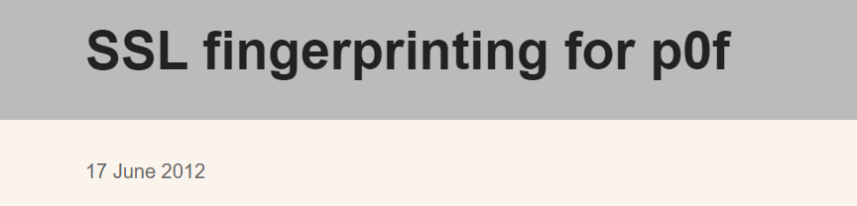
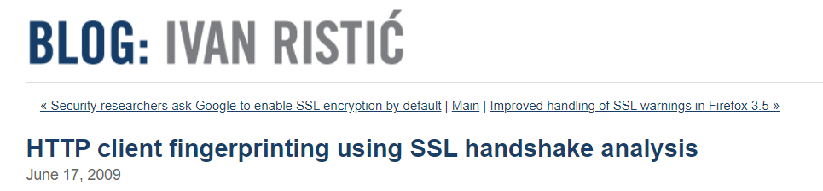
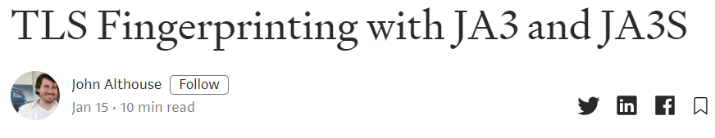
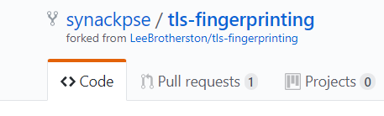
TLS Fingerprinting: Is it new?
“A technique to identify a client application or a library based on parameters in the TLS traffic without decryption”. [1]

Slide 10
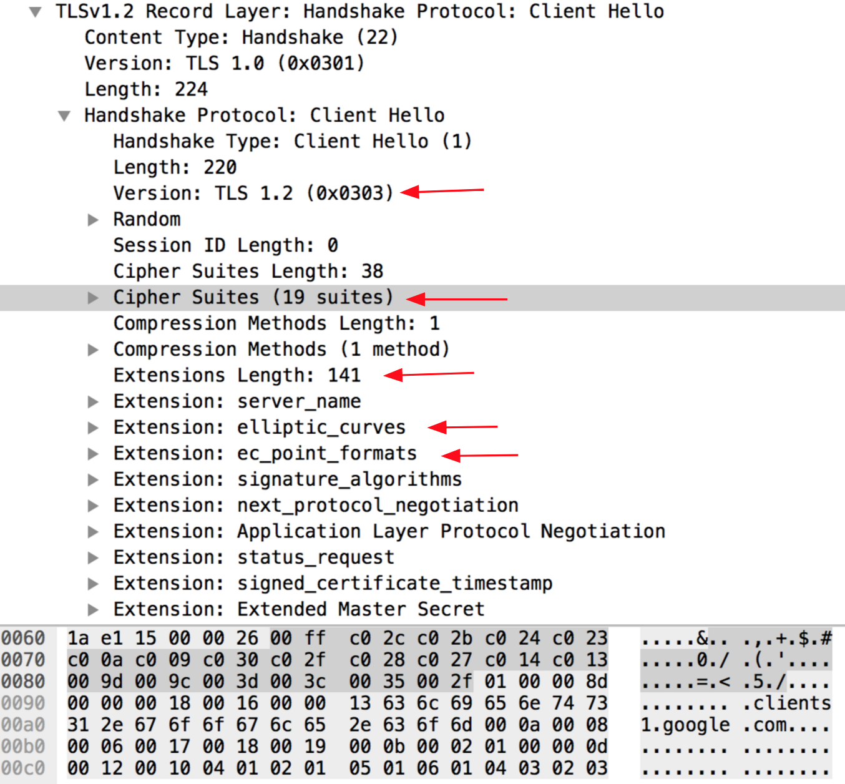
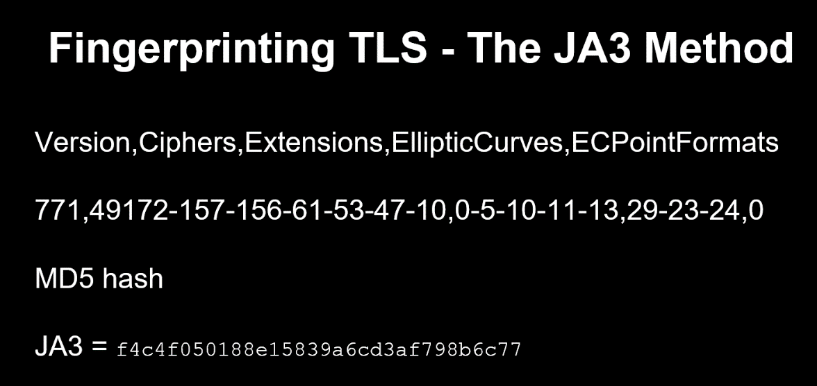
TLS Fingerprinting- The JA3 Method

Slide 11
TLS Fingerprinting- The JA3 Method
The JA3 method is used to gather the decimal values of the bytes for the following fields in the Client Hello packet:
Version, Accepted Ciphers, List of Extensions, Elliptic Curves, and Elliptic Curve Formats.
These strings are then MD5 hashed to produce an easily consumable and shareable 32 character fingerprint. This is the JA3 TLS Client Fingerprint.

Slide 12
JA3 Hunting Methodology
Network Data Collection
Baseline each host using JA3, JA3S
Network Threat hunting and Analysis
Data Enrichment & Correlation
Notification & Reporting

Slide 13
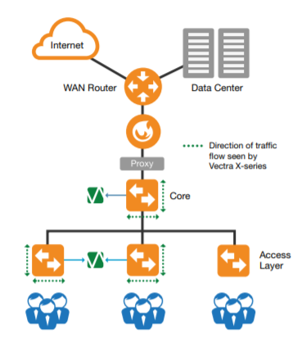
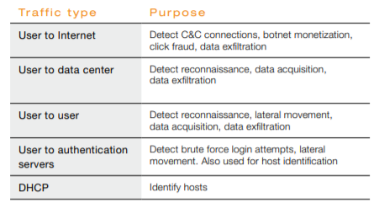
Network Data Collection
Source: Vectra Deployment

Slide 14
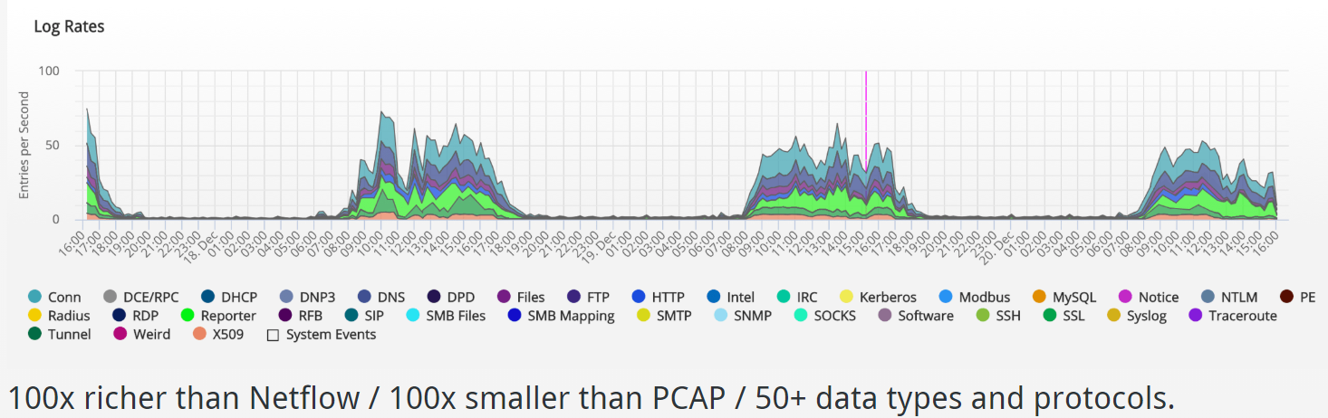
Zeek/Bro: balanced network visibility
Source: Corelight Website

Slide 15
Baseline each host using JA3, JA3S
Hosts
JA3_1
JA3S_1
JA3S_2
JA3_2
JA3S_1
JA3S_3
JA3_N
JA3S_2
JA3S_M
Host_X
time
Time period (TBD, i.e. days, etc.)

Slide 16
Baseline each host using JA3, JA3S
Hosts
Host_Z (T)
…
…
Host_Y (T)
Host_Y (T+1)
…
Host_X (T)
Host_X (T+1)
time
Time period (TBD, i.e. days, etc.)

Slide 17
Network Threat hunting and Analysis
Searching
Clustering
Grouping
Stack Counting

Slide 18
Data Enrichment & Correlation
Network telemetry (Zeek)
Host telemetry (Sysmon, EDR, SIEM )
IP source/dest, Port Source/dest (flow)
JA3, JA3S
IP source/dest, Port Source/dest (flow)
Process Name
Matching using flow
Process Name, JA3, JA3S

Slide 19
Notification and Reporting
Benign JA3 list
Malicious JA3 list
Suspicious JA3 list
Unknown JA3 list

Slide 20
Application of the methodology (PoC)
5,3 millions TLS flows
4,4 millions certs -> 12k unique certs
5,3 millions JA3 ->
360 unique JA3 / 660 unique JA3S
5 Hours of TLS traffic : PCAP of 522 Gb (avg 2G/min)

Slide 21
Data extracted from Zeek SSL/TLS Logs
Timestamp
IP source
JA3
Port Source
IP dest
Port dest
JA3S

Slide 22
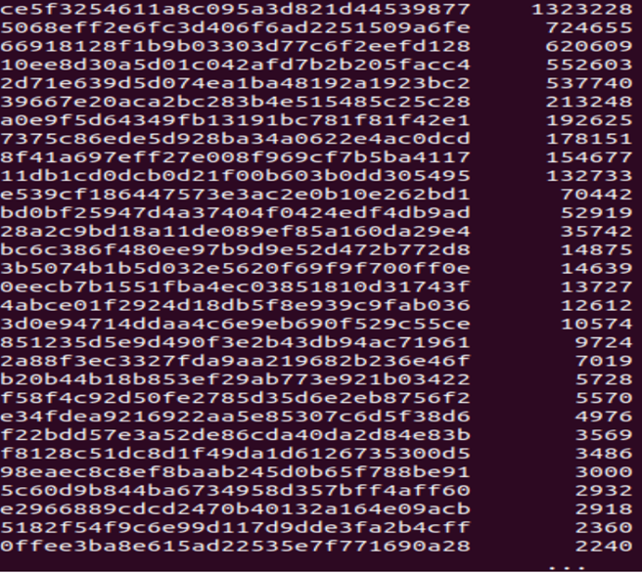
Stack Counting of JA3 (5,3 M TLS Flows)
JA3 occurrence
Top Occurrence JA3 : Usually Safe

Slide 23
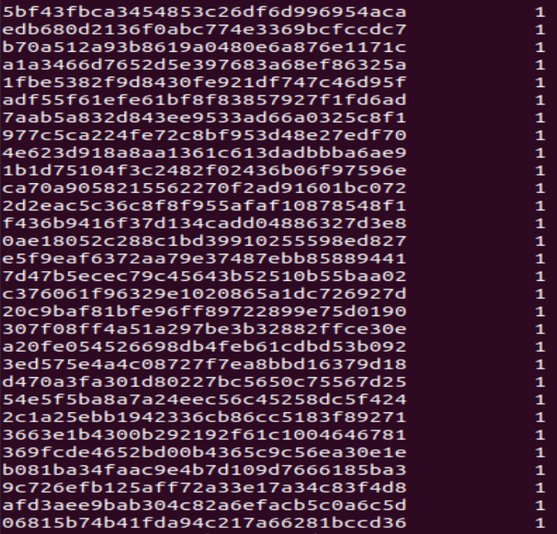
Stack Counting of JA3 (5,3 M TLS Flows)
JA3 occurrence
Rare Occurrence JA3 : Need Investigation

Slide 24
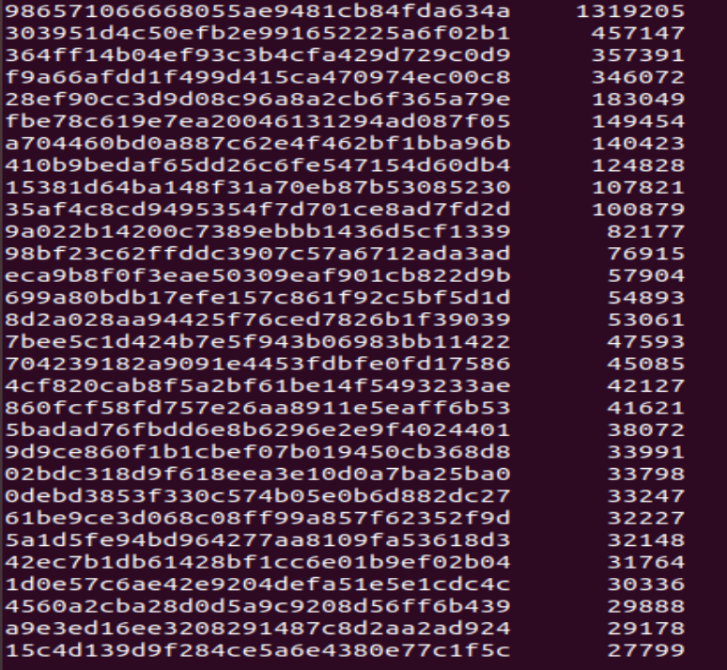
Stack Counting of JA3S (5,3 M TLS Flows)
JA3S occurrence
Top Occurrence JA3S : Usually Safe

Slide 25
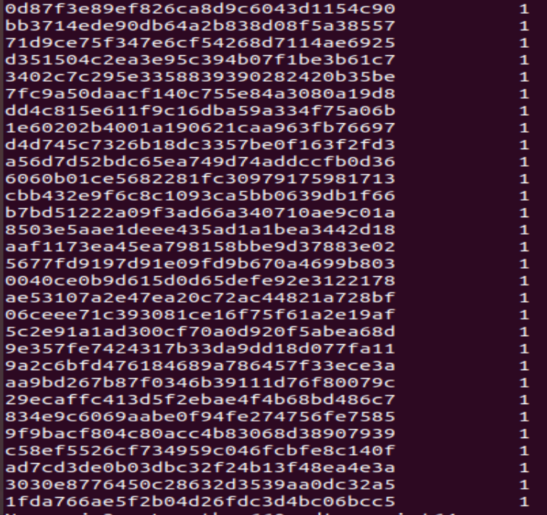
Stack Counting of JA3S (5,3 M TLS Flows)
JA3S occurrence
Rare Occurrence JA3S : Need Investigation

Slide 26
To be continued
Group by (JA3, JA3S)
Group By (JA3, IP Source)
Group By (IP dest, JA3S)
Group By (IP source, JA3, IP dest, JA3S)
Time Series Analysis
TLS Beacon Detection

Slide 27
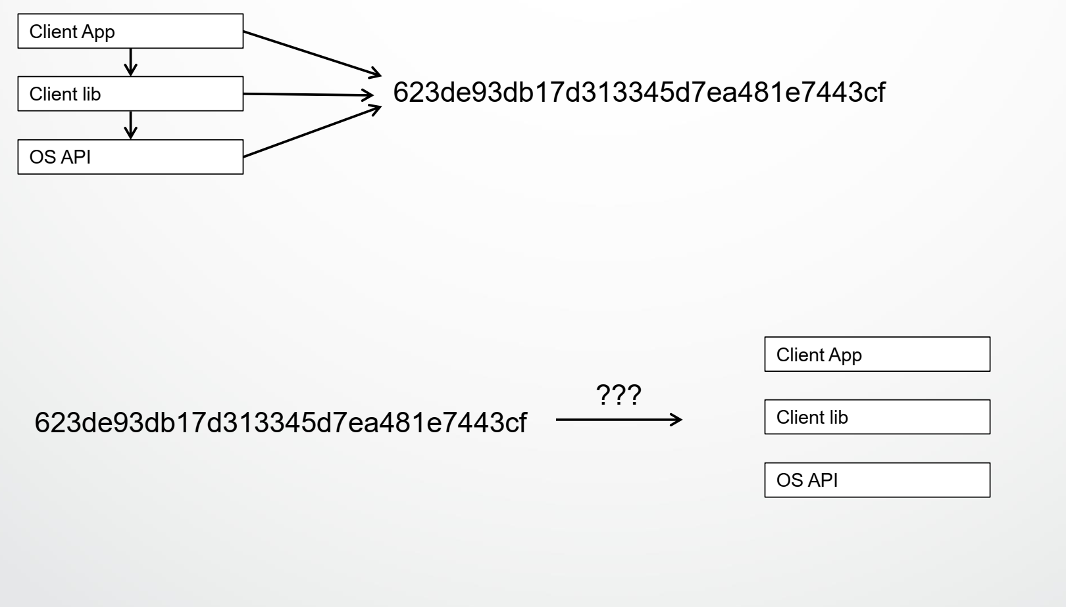
Limitation 1 : JA3 Collision
Source : Kjell Tore Fossbakk, HelseCert

Slide 28
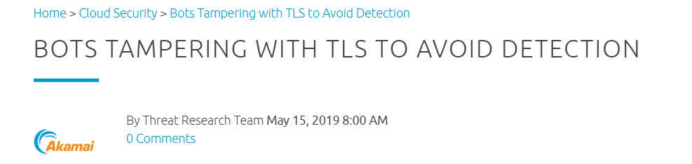

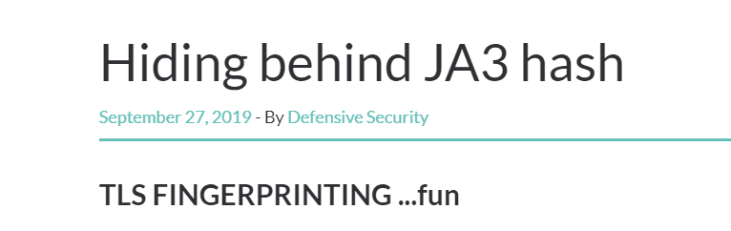
Limitation 2 : Impersonating JA3

Slide 29
Thank you Demo/Questions

Slide 30
References
https://docs.zeek.org/en/stable/script-reference/log-files.html
https://info.vectra.ai/hubfs/no_index/compliance/cb_mitre_082318.pdf
https://www.mbsecure.nl/blog/2019/5/dettact-mapping-your-blue-team-to-mitre-attack
https://www.corelight.com/products/software
https://www.cloudflare.com/learning/ssl/what-happens-in-a-tls-handshake/
https://filtermax.hu/files/download/Vectra_DeploymentGuide.pdf
https://www.linkedin.com/pulse/four-common-threat-hunting-techniques-sample-hunts-ely-kahn/

Slide 31
References
https://github.com/cisco/joy
https://blog.ivanristic.com/2009/06/http-client-fingerprinting-using-ssl-handshake-analysis.html
https://idea.popcount.org/2012-06-17-ssl-fingerprinting-for-p0f/
https://github.com/synackpse/tls-fingerprinting
https://github.com/salesforce/ja3
https://resources.sei.cmu.edu/library/asset-view.cfm?assetID=449962
https://www.cisco.com/go/anyconnect
https://www.cisco.com/go/threatgrid
https://www.cisco.com/go/eta

Slide 32
What is Transport Layer Security (TLS)?
Transport Layer Security, or TLS, is a widely adopted security protocol designed to facilitate privacy and data security for communications over the Internet. A primary use case of TLS is encrypting the communication between web applications and servers, such as web browsers loading a website.

Slide 33
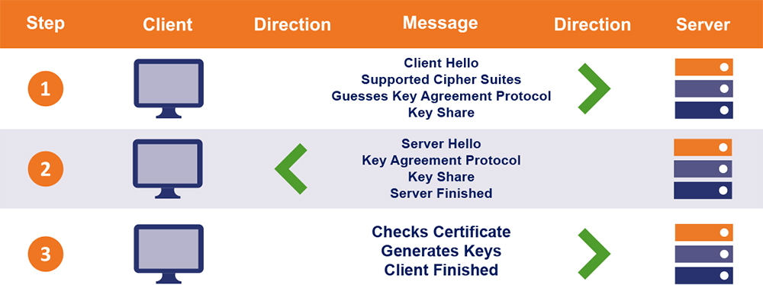
TLS V1.3 Handshake

Slide 34
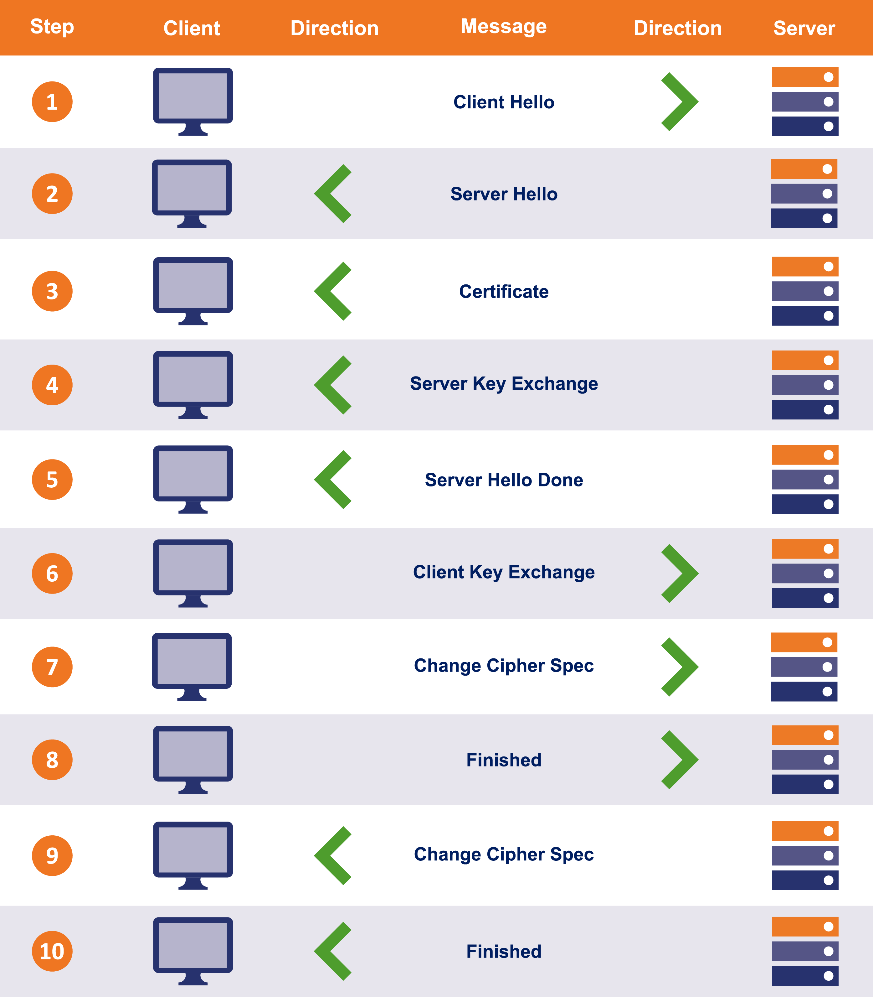
TLS V1.2 Handshake

